Slide 1

SPORTS
Joel Augustine
Roll no:- 04
MCA B

Slide 2
Introduction
Types
ON-ptich
OFF-pitch
“The greatest value of a picture is when it forces us to notice what we never expected to see.”

Slide 3
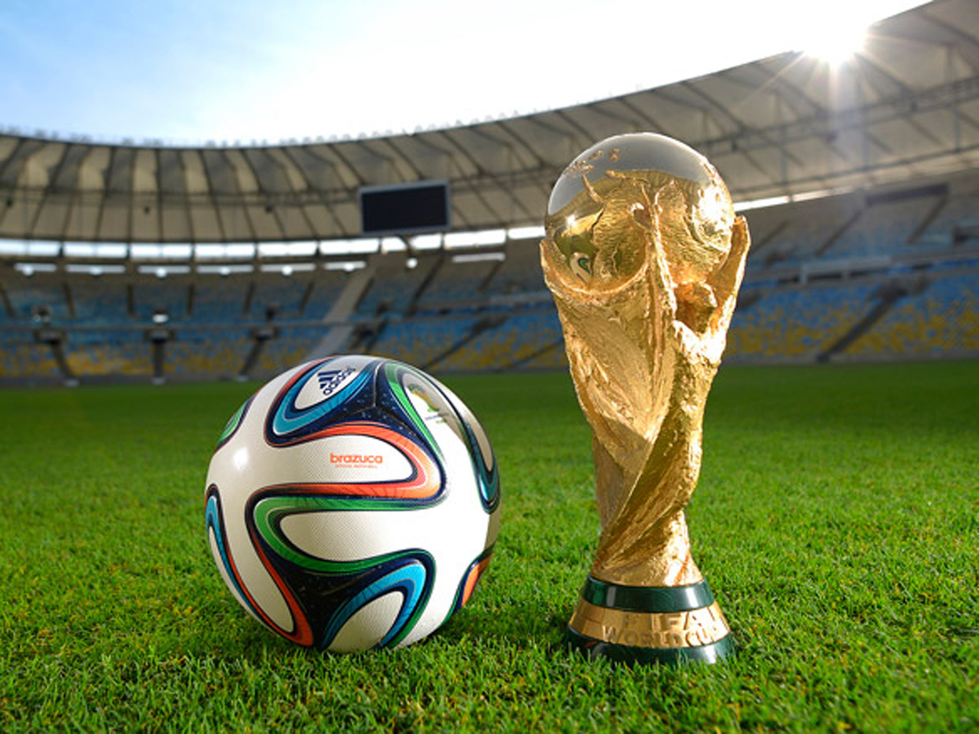
Dataset
FIFA World Cup

Slide 4
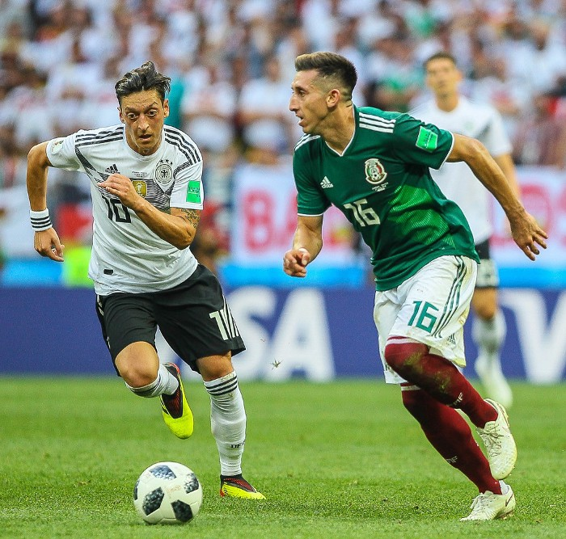
Main Focuses
Mesut Özil - Germany

Slide 5
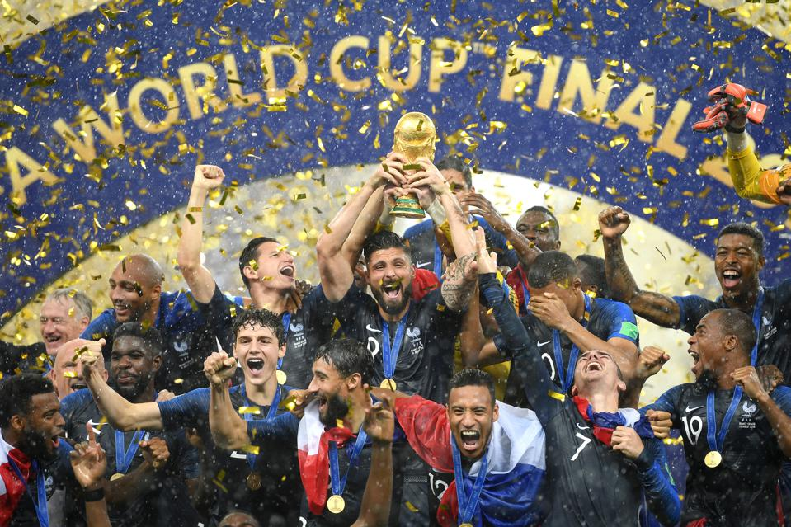
Contin.
France

Slide 6
Relevance
Possible to predict potential athletes.
Customizing game strategies and play an immeasurable role for winning competitions.

Slide 7

Conclusion
We are able to analyse each and every player.
Team chemistry can be improved.
Player potential can be boosted.
ON and OFF pitch boosts.

Slide 8
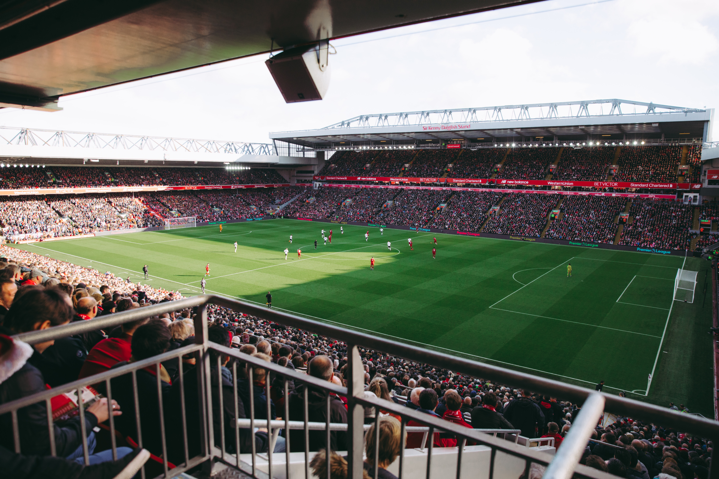
Future Scope
Predicting a winning team.
Home team advantage influence.

